Slide 1
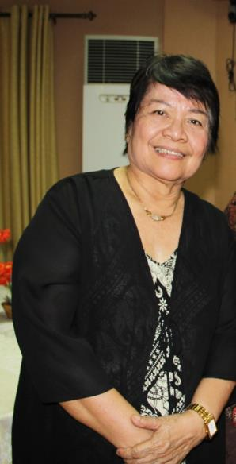
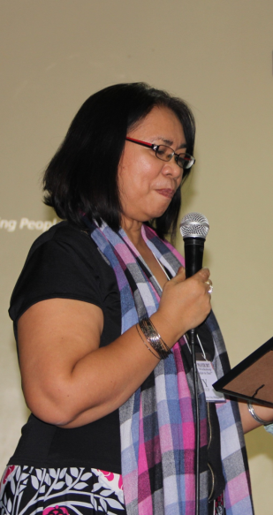
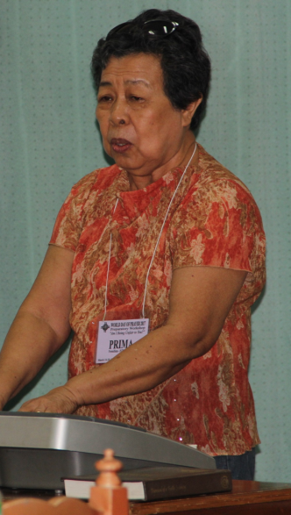
Dorothy Castro
CWUP President
Zenaida Maturan
Former WDPIC Regional Rep
Prima Formilleza
WDP President
© Cherina Ducusin

Slide 2
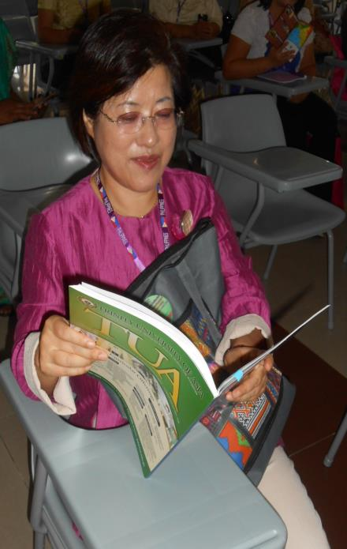
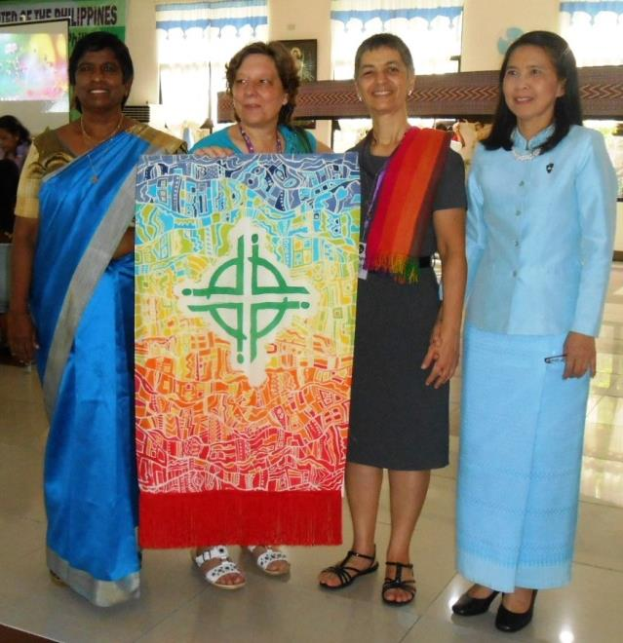
Rev Moon Sook Lee
© WDPIC

Slide 3
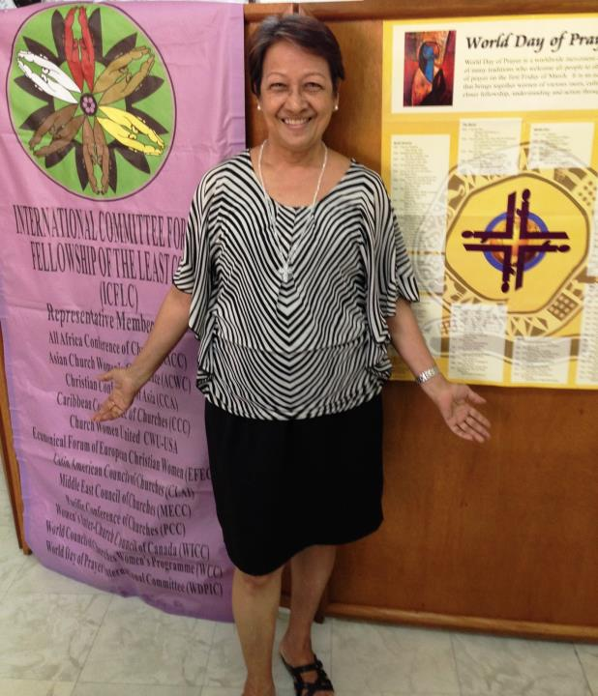
Corazon Reyes
Fellowship of the Least Coin
© WDPIC

Slide 4
© 2014 by International Committee for the Fellowship of the Least Coin

Slide 5
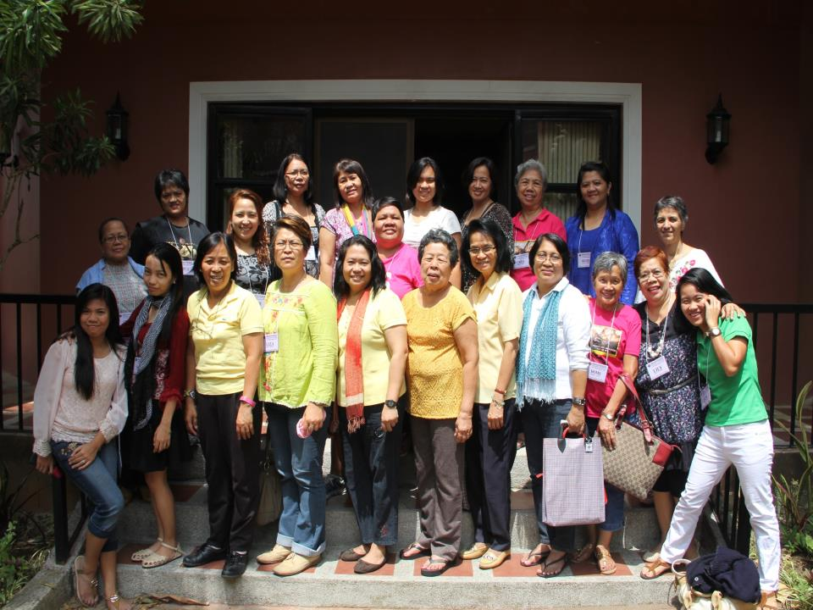
25. Preparatory Workshop With WDPIC
© Cherina Ducusin

Slide 6
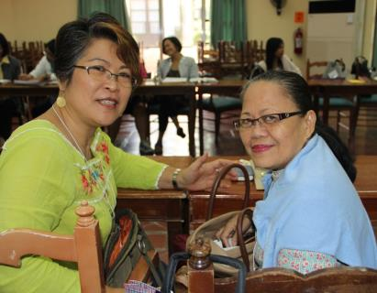
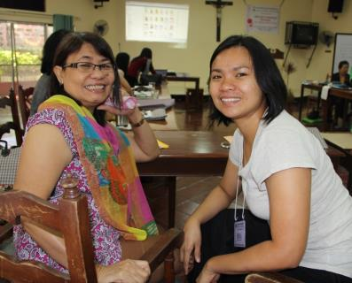
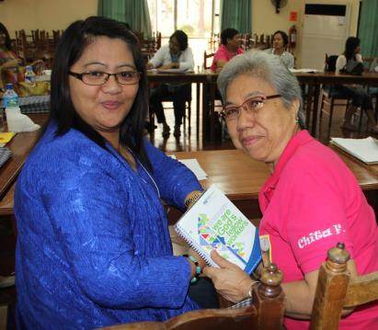
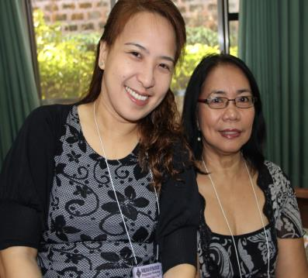
© Cherina Ducusin

Slide 7
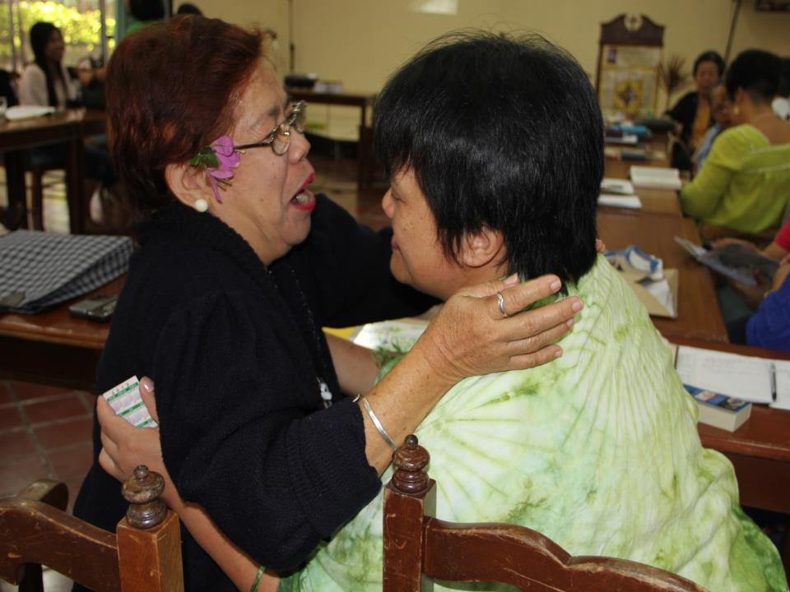
© Cherina Ducusin

Slide 8
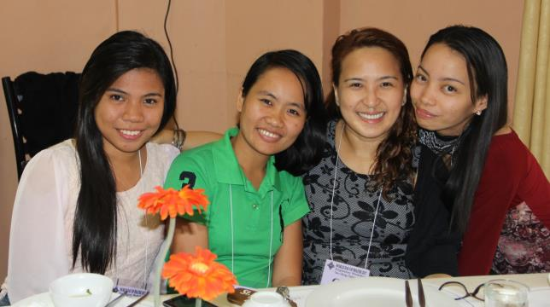
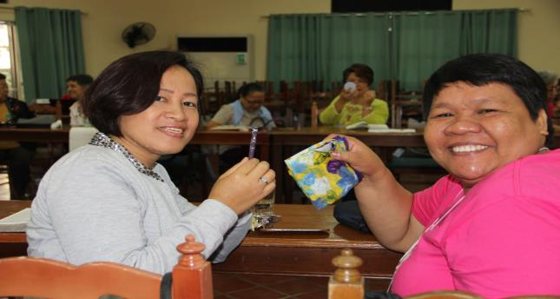
© Cherina Ducusin

Slide 9
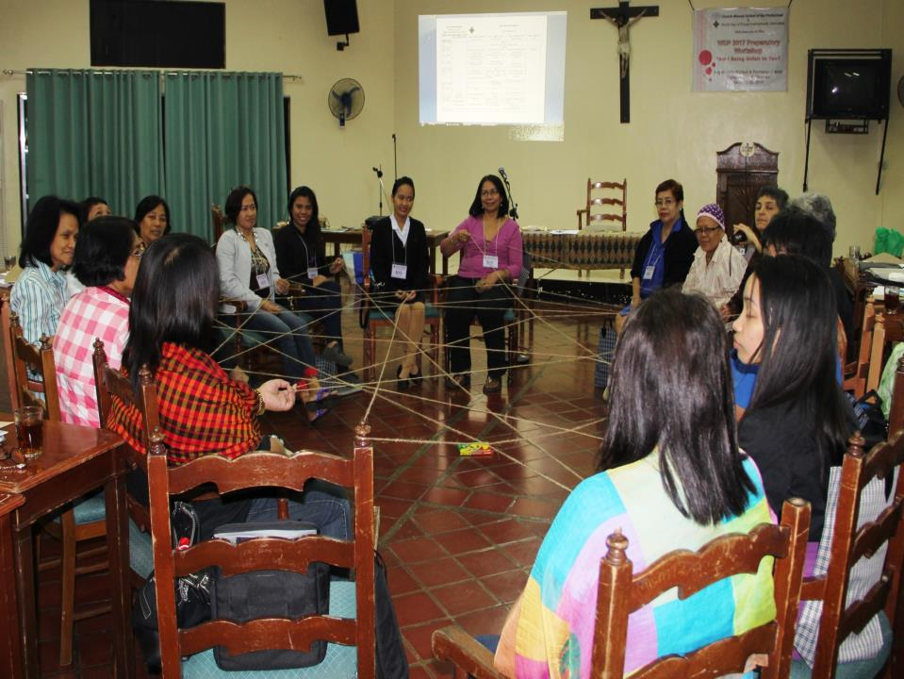
© Cherina Ducusin

Slide 10
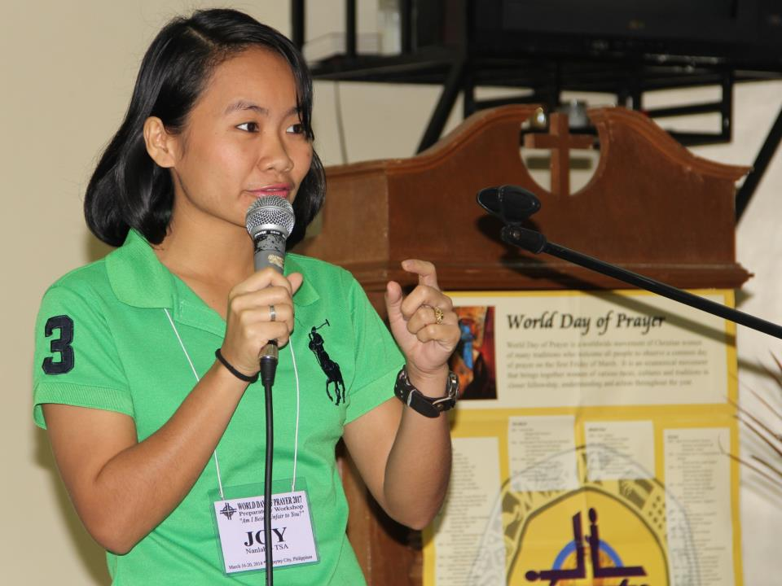
© Cherina Ducusin

Slide 11
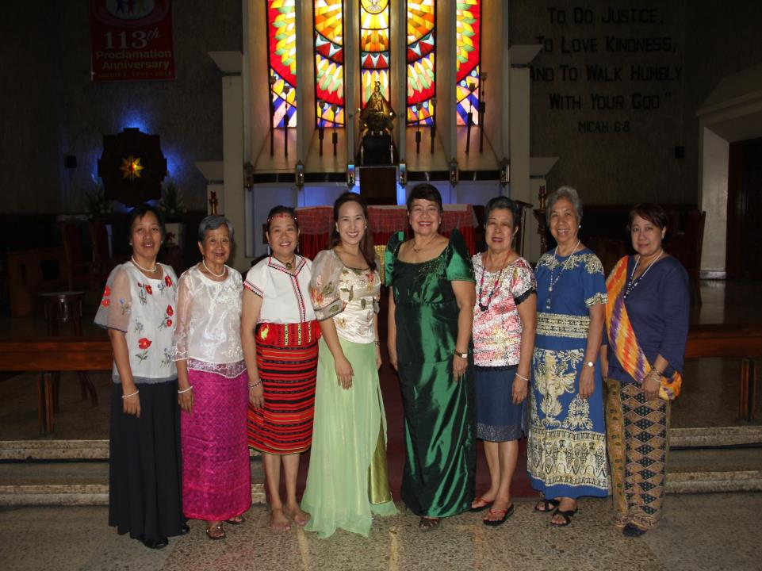

Slide 12
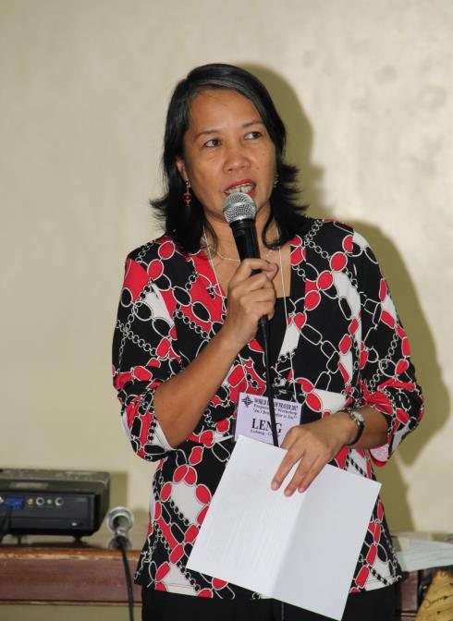
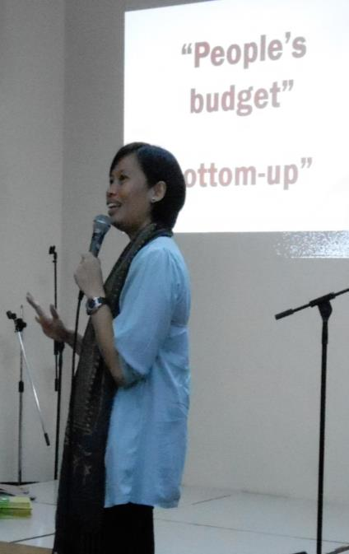
© Cherina Ducusin
© WDPIC

Slide 13
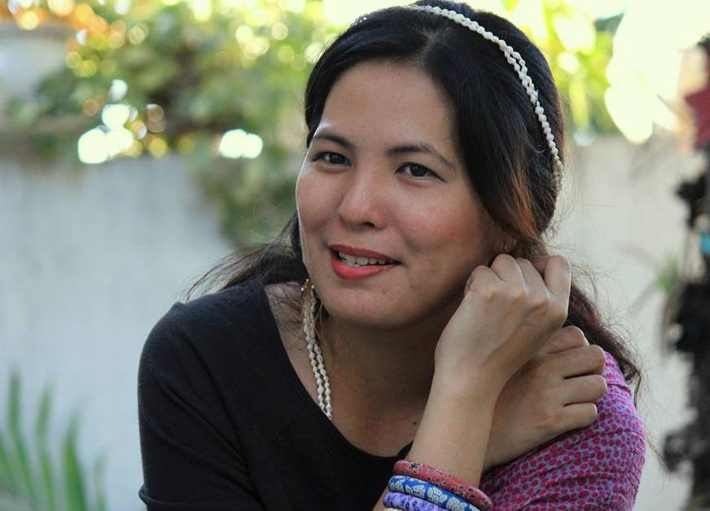
© WDP Philippines
26. Artist: Rowena “Apol” Laxamana-Sta.Rosa

Slide 14
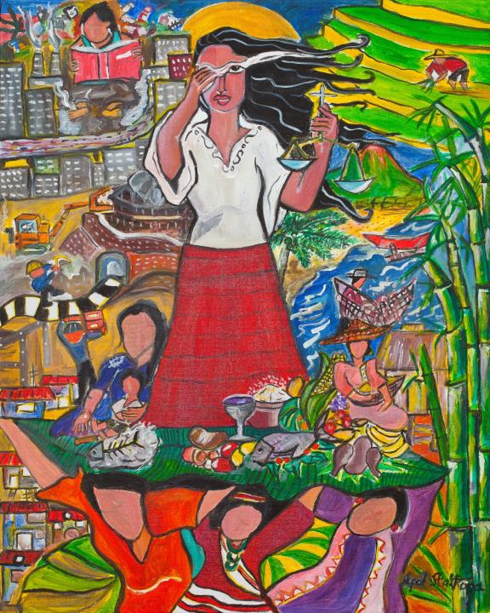
A Glimpse of the Philippine Situation by Rowena Apol Laxamana-Sta. Rosa
© WDP Philippines

